Slide 1
Fundamental Programming
SCSE 1013
Semester 1, 2024/2025
Faculty of Computing, UTM

Slide 2
10: Transformation From Structured To Object-oriented Paradigm
Fundamental Programming
(SCSE 1013)
Adapted from Tony Gaddis and Barret Krupnow (2016), Starting out with C++: From Control Structures through Objects

Slide 3
Contents
Object Oriented Programming Principles
Class and Object Manipulations
Associations, Aggregations and Compositions
Inheritance and Polymorphisms

Slide 4
Intro: Types of Programming Languages
Procedural Programming (PP) - Example: C, Pascal
Functional Programming (FP) – Example: Scala, Erlang, Haskell
Object-Oriented Programming (OOP) – Example: Java, Phyton, C++
Scripting Language – Example: PHP, Ruby, Node.js
Logic Programming Language – Example: Prolog, Datalog

Slide 5
Procedural Programming (PP)
Traditional programming languages were procedural.
  C, Pascal, BASIC, Ada and COBOL
Programming in procedural languages involves choosing data structures (appropriate ways to store data), designing algorithms, and translating algorithm into code.
In procedural programming, data and operations are separated.
This methodology requires sending data to procedure/functions

Slide 6
Procedural Programming
Data Element
Function A
Function B

Slide 7
Functional Programming (FP)
FP is a programming paradigm where programs are constructed by applying and composing functions
Functions are treated as first-class citizen. They can be:
  bound to names
  passed as parameters to other functions
  returned from other functions
FP uses declarative programming style
  expresses the logic of WHAT the program should accomplish without specifying how it should achieve that.
  Note: PP and OOP use imperative programming style. This style focuses on describing HOW a program operates

Slide 8
Object-Oriented Programming
Object
Programming
Interface
Attributes
typically, private to this object
Methods
Other
objects
Other
objects
Other
objects

Slide 9
Object-Oriented Programming
Object-oriented programming combines data and methods via encapsulation.
Data hiding is the ability of an object to hide data from other objects in the program
Only object’s methods should be able to directly manipulate its attributes
Other objects are allowed to manipulate object’s attributes via the object’s methods.
This indirect access is known as a programming interface

Slide 10
OOP Principles: Classes
A class is the template or mould or blueprint from which objects are actually made.
A class encapsulates the attributes and actions that characterizes a certain type of object.

Slide 11
OOP Principles: Objects
Classes can be used to instantiate as many objects as are needed.
Each object that is created from a class is called an instance of the class.
A program is simply a collection of objects that interact with each other to accomplish a goal.

Slide 12
Classes and Objects
The Car class defines the attributes and methods that will exist in all objects
that are instances of the class.
Kancil object
The Kancil object is an
instance of the Car class.
Car class
The Nazaria object is an
instance of the Car class.
Nazaria object

Slide 13
OOP Principles: Encapsulation
Encapsulation is a key concept in working with objects: Combining attributes and methods in one package and hiding the implementation of the data from the user of the object.
Encapsulation:
Attributes/data
+
Methods/functions = Class
Example:
a car has attributes and methods below.
Car
Attributes:
model,
cylinder capacity
Methods:
move,
accelerate

Slide 14
OOP Principles: Data Hiding
Data hiding ensures methods should not directly access instance attributes in a class other than their own.
Programs should interact with object attributes only through the object's methods.
Data hiding is important for several reasons.
  It protects attributes from accidental corruption by outside objects.
  It hides the details of how an object works, so the programmer can concentrate on using it.
  It allows the maintainer of the object to have the ability to modify the internal functioning of the object without “breaking” someone else's code.

Slide 15



OOP Principles: Associations
Association: relates classes to each other through their objects.
Association can be, one to one, one to many, many to one, or many to many relationships.
Example:
A person can own several cars
Person
Car
owns
0..*
Works for
Company
A person works for a company

Slide 16

OOP Principles: Inheritance
Inheritance is the ability of one class to extend the capabilities of another.
  it allows code defined in one class to be reused in other classes
Example:
Vehicle represents all
of the generic attributes
and methods of a vehicle.
Vehicle
Vehicle is the
parent class.
“is-a” relationship
Car and Truck are
Specialized versions of
a Vehicle.
Car
Truck
Car and Truck are
child classes of
Vehicle.

Slide 17
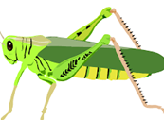

OOP Principles: Polymorphism
Polymorphism is the ability of objects performing the same actions differently.
Example:
Insects have the ability to move from one point to another.
However, the way they perform their movement is different
Insect
Ant
Grasshopper
Ants move by crawling
Grasshoppers move by jumping

Slide 18
Introduction to Associations
Association: Indicates relationships between classes through their objects
Association can be, one to one, one to many, many to one, or many to many relationships.

Slide 19
Introduction to Associations
Example:
Lecturer
Student
Teaches
0..*
lecturer
students
Lecturer
Student
Advises
0..*
courseAdvisor
advisees
Lecturer
Student
Supervises
0..*
supervisor
postGraduates

Slide 20
Introduction to Aggregations
Aggregation: a special type of association which is one way relationship.
It models a ‘has a’ relationship between classes – enclosing class ‘has a’ enclosed class.
The existence of the objects (enclosing and enclosed) are independent.

Slide 21
Introduction to Aggregations
Example:
Wallet
Money
0..*
A “has a” relationship: Wallet has Money
Independence: However, money does not necessarily need to have Wallet.
Money objects can be created even though there is no Wallet object.

Slide 22
Implementations of Aggregations
An aggregation relationship is implemented by objects contain pointers to other objects.
  it is because the existence of the enclosing and enclosed objects are independent.
  If one party is destroyed, the other party still exists.
  the relationship between objects can be broken by only disconnecting the pointer.
Example:
  Consider course registration system.
  A student may enroll to a course. If the student quits from his or her study. In this case, his or her record will be removed from the system. However, the course needs to remain as other students are still enrolled to the course.
  Relationship between students and courses should be done by an aggregation.

Slide 23
Implementations of Aggregations
Aggregation - declare attributes as object pointers.
The pointers can be set to NULL to represent no object.
  class Student
  { private:
  Course *course;
  public:
  Student(){course = NULL;}
  void enrollCourse(Course *);
  void withdrawCourse();
  ..};
Use a pointer rather than object.

Slide 24
Implementations of Aggregations
  void Student::enrollCourse(Course* c){
  course = c;
  }
  void Student::withdrawSubject(){
  course=NULL;
  }
The course should be passed rather
than the object student create it itself,
as the course is shared with other students.
..and when a student withdraw the course,
we just need to break the link/pointing, and not to “delete” the course.
Other students might still be using the course.

Slide 25
Implementations of Aggregations
A course can be created
independently as it does not belong to any student.
  int main()
  {
  Course c1(“SCSJ1023”,”Prog. Tech. 2”);
  Student s1 = new Student;
  Student s2, s3;
  s1->enrollCourse(&c1);
  s2.enrollCourse(&c1);
  s3.enrollCourse(&c1);
  ….
  delete s1;
  }
Pass course as a pointer
The student is deleted from the system as he or she has dropped out from the study. However, the course c1 still exists.

Slide 26
Introduction to Compositions
Composition: a restricted version of aggregation in which the enclosing and enclosed objects are highly dependent on each other.
The existence of the enclosed objects are determined by the enclosing objects.
It models a whole/part relationship with a strong ownership; when the whole dies, the part does so as well
  enclosing objects(whole) ‘has / contains/ consists of’ enclosed objects (parts)
  Alternatively: the enclosed object is “part of” the enclosing object.
An object can be only part of one whole object
The whole object is responsible for creation and destruction of its part(s)

Slide 27
Introduction to Compositions
Example:
Body
Heart
A “whole-part” relationship: human Body “consists of”/”has” Heart, or Heart “is part” of human Body.
Dependence: A human body needs heart to live and a heart needs a human body to survive. If one dies then another one too.
If the Body object is destroyed then Heart object also will be gone.
When a Body object is created, the Heart object is also created.

Slide 28
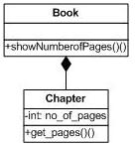
Implementations of Compositions
Composition is implemented by the nested objects, i.e., whole objects contain the part objects.
  it is because the existence of the whole (enclosing) and part (enclosed) objects are dependent.
Example:

Slide 29
Implementations of Compositions
class Chapter{
int nPages;
public:
Chapter(int pages);
int getPages();
};
Chapter::Chapter(int pages){
nPages = pages;
}
int Chapter::getPages(){
return nPages;
}
Constructor for Chapter
class takes an integer
argument to define
its pages

Slide 30
Class Book
includes objects of
class Chapter
class Book{
public:
Chapter c1, c2, c3, c4;
Book(int pages1, int pages2, int pages3,
int pages4):c1(pages1), c2(pages2),
c3(pages3),c4(pages4){ }
void showNumberofPages();
};
void Book:: showNumberofPages(){
cout<<"Total number of pages" <<
(c1.getPages() + c2.getPages()+
c3.getPages() + c4.getPages());
}
int main(){
Book pt2(200, 190, 50, 100);
pt2.showNumberofPages();
}
/*__________*/
Note use of colon(:) operator to initialize the enclosed objects using their constructors
The methods of the enclosed objects can be called to as usual.

Slide 31
Self-test: Introduction to Object Oriented Programming
State the differences between procedural programming and Object Oriented Programming.
What is an Object and what is a Class? What is the difference between them?
What is an Attribute?
What is a Method?
What is encapsulation? How it relates to data hiding?
What is association?
What is inheritance? How it relates to polymorphism?

Slide 32
The Unified Modeling Language

Slide 33
The Unified Modelling Language
UML stands for Unified Modelling Language.
The UML provides a set of standard diagrams for graphically depicting object-oriented systems

Slide 34
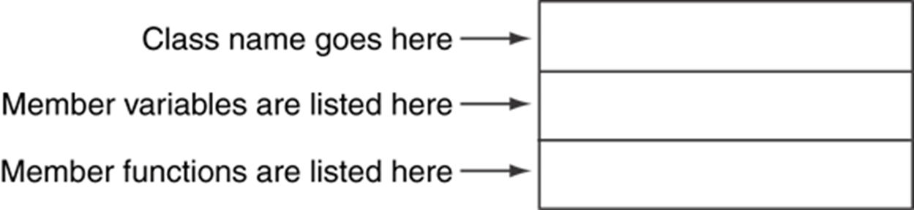
UML Class Diagram
A UML diagram for a class has three main sections.

Slide 35
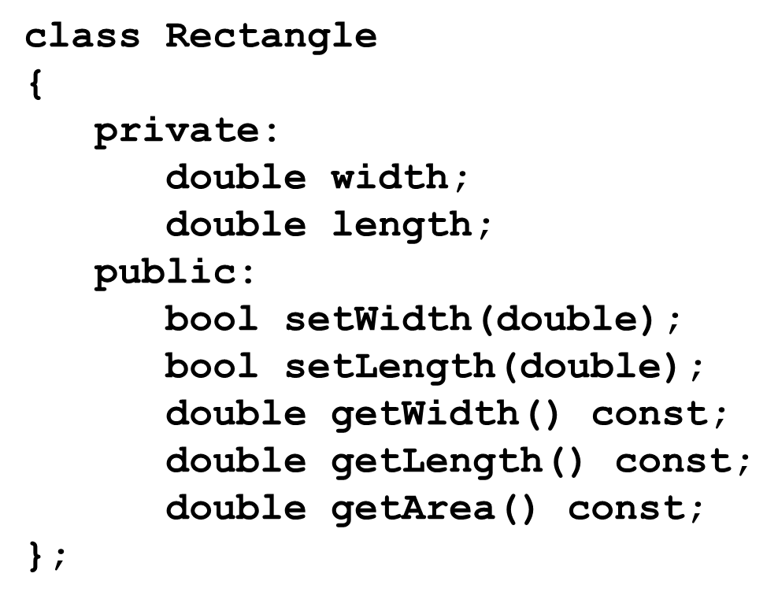
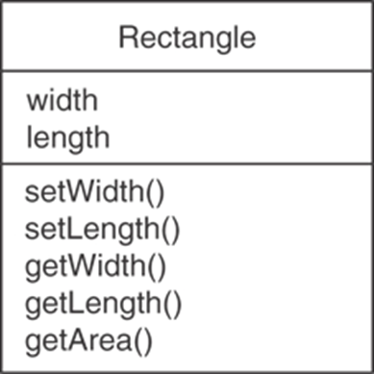
Example: A Rectangle Class
A UML diagram for a class has three main sections.

Slide 36
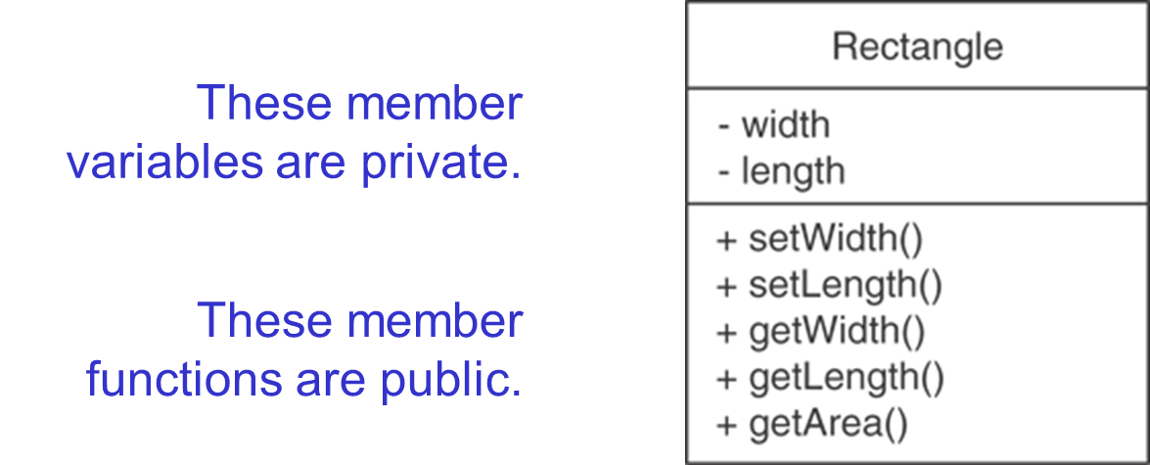
UML Access Specification Notation
In UML you indicate a private member with a minus (-) and a public member with a plus(+).

Slide 37
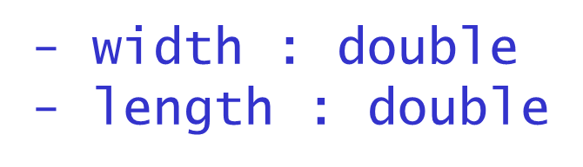
UML Data Type Notation
To indicate the data type of a member variable, place a colon followed by the name of the data type after the name of the variable.
.

Slide 38
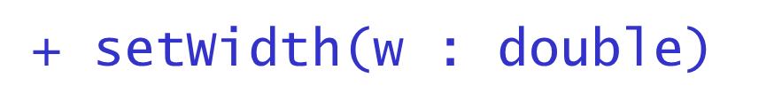
UML Parameter Type Notation
To indicate the data type of a function’s parameter variable, place a colon followed by the name of the data type after the name of the variable.
.

Slide 39
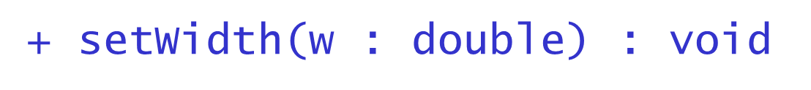
UML Function Return Type Notation
To indicate the data type of a function’s return value, place a colon followed by the name of the data type after the function’s parameter list.
.
.

Slide 40
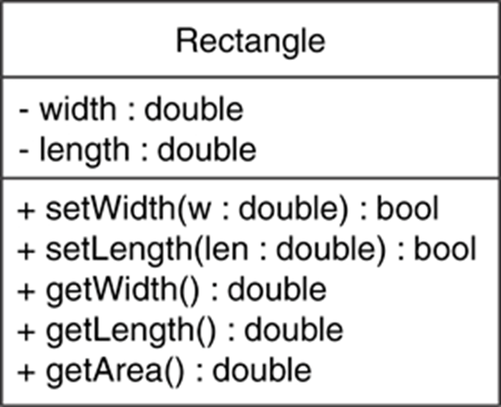
The Rectangle Class

Slide 41
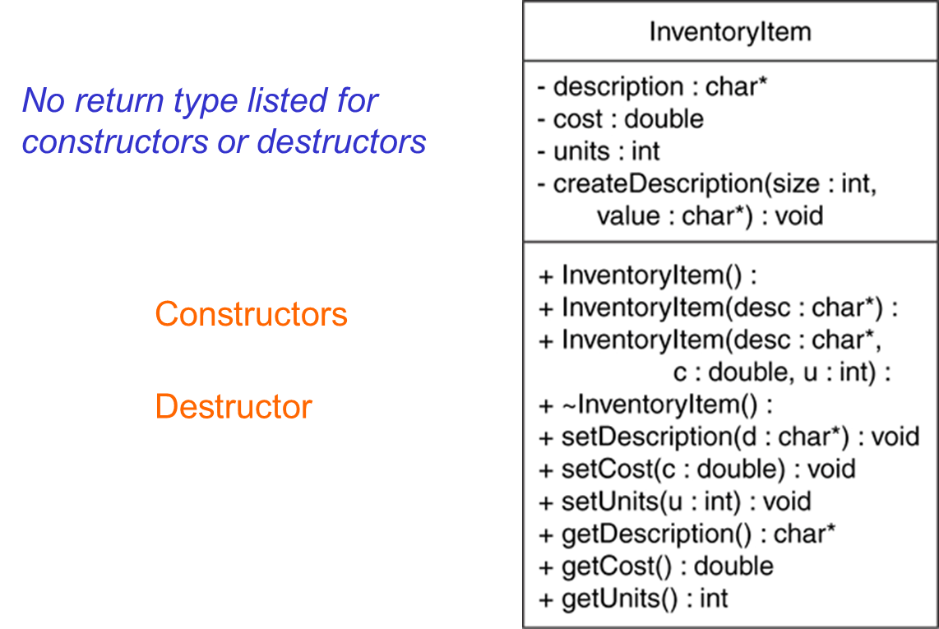
Showing Constructors and Destructors

